Slide 1
Parents new to Maths with Parents
www.mathswithparents.com
@parentmaths
Notes:
Welcome to Maths with Parents. This is a new programme to support your child’s Maths learning

Slide 2
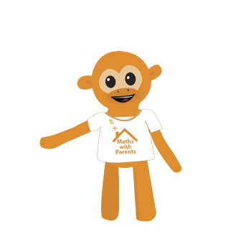
Maths with Parents
Learning outside the classroom makes such a difference to children’s progress in Maths and Maths with Parents has created fun ways for families to discover the fun in Maths together

Slide 3
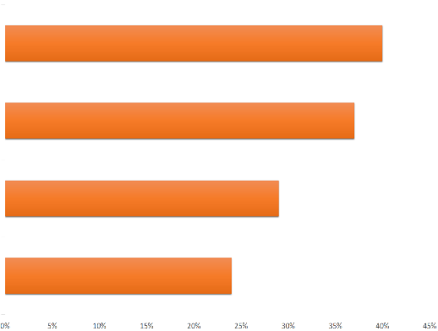
Maths at Home - The Challenges
New teaching methods
Time
Conflict (when trying to help)
Parent Confidence
In 2015 National Numeracy did a survey on parents, asking what are the barriers to them engaging with their children around maths. These are the top 4 barriers across the whole UK.
Notes:
We want your children to see Maths in the everyday world around them, and to have fun playing Maths games and activities with you at home but we understand, there can be a number of challenges when it comes to supporting your child in Maths at home.
National Numeracy did a survey in 2015 which revealed that the new teaching methods were the most common reason for parents no helping their child with Maths at home.
So even where confident in Maths abilities, the new teaching methods which include language and methods we do not always understand, can make supporting difficult and cause conflict - “you don’t do it that way, I was taught to do it like this”. Finding the time can also be a common challenge when looking to increase support at home.

Slide 4
New Teaching Methods – e.g. An Array
3
2
2 x 3 = 6
Notes:
Who studies Arrays when they were in school? (expects a very poor response)
This is an array. It is a series of shapes which we can use to help counting and multiplication.
This array is two tall by three wide, we can use it to help us count, but if we also spot patterns we can use it to demonstrate two and three times tables. Which is much more effective than the way it used to be taught by rote learning and repetition of specific times tables.
And once we can see how useful this is, we can start to see arrays everywhere, from egg boxes, baking trays, windows etc. Brilliant! This is maths in action, and a great way for us to try and help our children to use these methods outside of school….. In everyday life, helping them see how important it is.
BUT we can only do this If only we know what the methods are!

Slide 5
Child
Games and activities to play
School and Teachers
Parent
Tools to engage in the
learning and feedback to teachers
Curriculum focused and live feedback
Notes:
Maths with Parents has been created to support parents, children, and the school. It bring together education across all of these spheres, bringing learning into the home and helping children practice what they learn in the classroom, and giving you easy ways to help them with maths
Parents – are provided with the tools to engage in the curriculum and feedback to teachers on their child’s learning
Schools – are able to make at home support strictly relevant to the current curriculum and to receive feedback from the home
Children – have fun games and activities to play which are designed to deepen their understanding and enjoy learning at home too.

Slide 6
Some Maths!
Notes:
Before we look at the site, will do some Maths with a Maths with Parents activity so you can see an example!

Slide 7
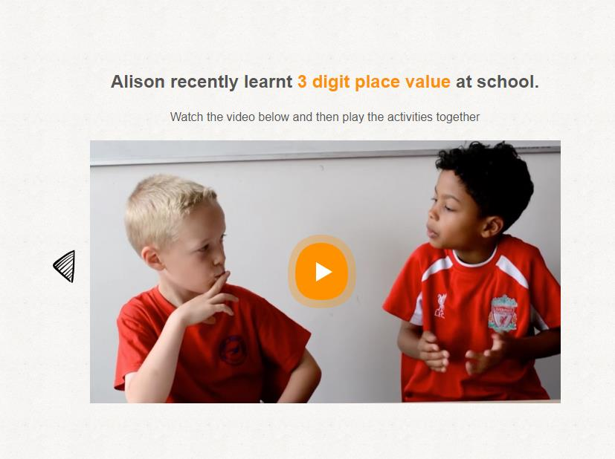
Notes:
Here is an example for 3 digit place value
Watch the video

Slide 8
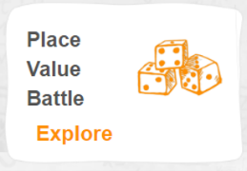
Notes:
Then we choose and activity.

Slide 9
Notes:
You will need to have pens and small scraps of paper available in the room. Either print off (and explain that if there are essential resources – these will be printed off by the school the day before) or ask parents to draw the grid on a piece of scrap paper.
Parents will need to be in pairs

Slide 10
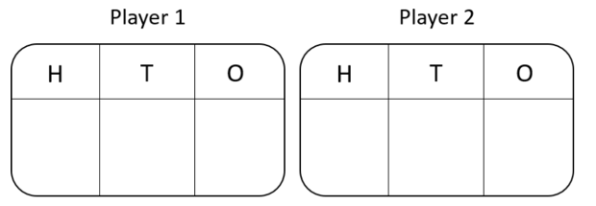
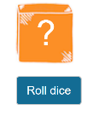
Version 1 (‘the friendly version’!)
Take it in turns to roll the 0-9 die. Once you have a number, you can write it into any of your place value squares, either hundreds, tens, or ones. The aim of the game is to be the player with the greatest 3-digit number at the end… Good luck!
Notes:
Rather than waiting for the group to roll the dice separately, you can do so on behalf of the whole room. Also emphasise that the dice is available on the website, to make sure that parents need minimal resources in the home as want to make this easy for everyone to use.
Once the group have played one round, or perhaps two rounds, you can try the next ‘nastier’ version

Slide 11
Version 2 (‘the nasty version’!)
The game is played as previously but this time a player can also place their number on one of their opponent place value squares, rather than their own… Good luck!

Slide 12
What will you be doing at home?
Notes:
So – what will everyone be doing at home?!

Slide 13
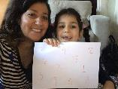
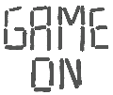
Teachers choose the topic
Maths with Parents emails to let you know it is time to login
Notes:
Teachers choose the specific topic children are learning that week
You will receive an email to let you know it is time to login

Slide 14
Watch the video together
Notes:
1) Watch the video together.

Slide 15
Choose which activity to play first!
Notes:
Pick which activity to play first. There are two games/activities to play. These are offline and often involve finding things around the house. If the games need print-outs, we email these to the class teacher the day before to print and hand out

Slide 16
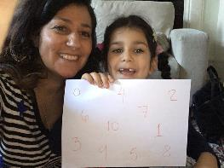
Write a comment or upload a photo for the teacher to let them know how you got on
Notes:
Comment or upload a photo (include if going to display photos etc.)

Slide 17
Once you have commented, choose an item for your Monkey Mathscot!
Notes:
Once a comment or photo is left, choose an item for your Monkey Mathscot!
The more topics completed, the sillier they can make their Mathscot look!

Slide 18
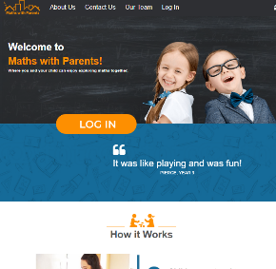
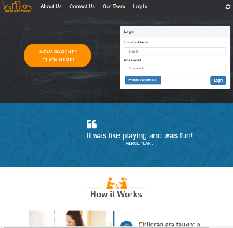
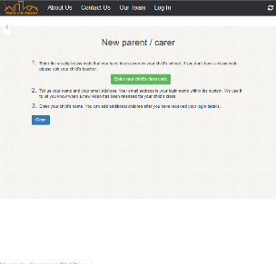
Registration
1
2
3
Notes:
Will register and log in next. Quickly we will show you through what this looks like on the site.
To register – 1) Log In, 2) New Parent, 3) Enter details. This will then show you your password so you can then log in for the first time straight away

Slide 19
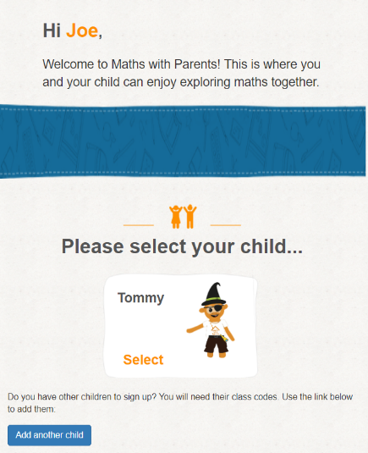
Logged In
Click on your child’s Mathscot
Notes:
This will be the screen you always see when you login
This Monkey Mathscot will be yours to dress up together throughout the year!
Can add another child so you will only ever need one log in for each adult accessing the site
Can also have multiple parents/family members linked to each child. Just make sure you enter the child’s name exactly the same

Slide 20
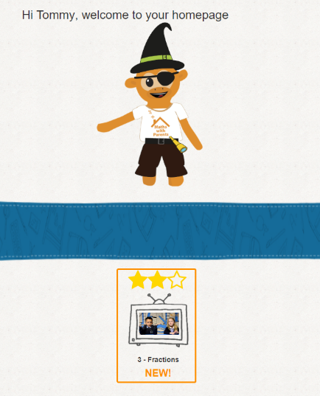
Throughout the year
Current topic
Notes:
This is what you will do each time you login. The new topic will be clearly at the bottom of the screen.
The stars show how much of it you have completed.
1st Star – Watched the video
2nd Star – First Activity completed with feedback
3rd Star – Second Activity completed with feedback

Slide 21
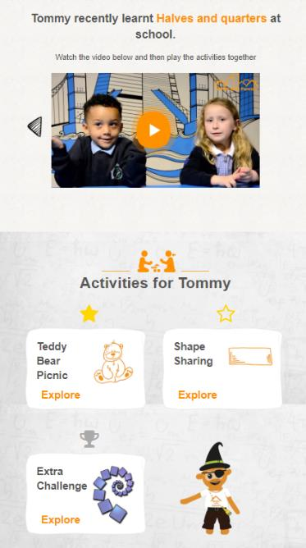
Topics
1
Click to watch the video
Choose your activity!
Notes:
So for each topic you will need to do the following:
1) Watch the video. Only once you have watched it, the activities will appear

Slide 22
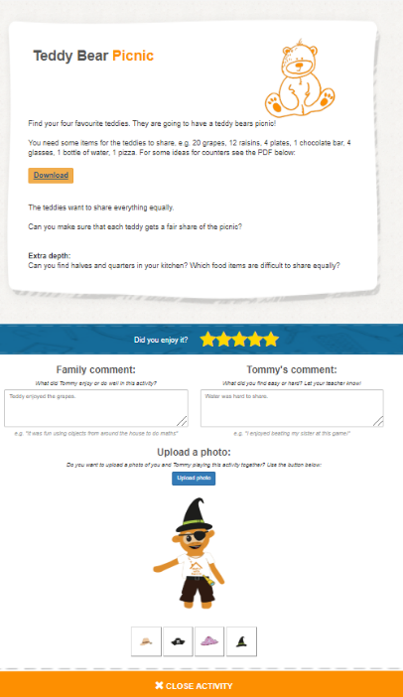
Topics
2
Play the activity together
3
Rate the activity
4
Leave a family and child comment or upload a photo
5
Choose an item for your Monkey Mathscot!
Notes:
2) Play the activity together - Sometimes these have some additional help or ideas you can download
3) Rate the activity
4) Leave parent and child comments, and/or upload a photo - This feedback is really helpful for class teachers to know how you are getting on. It is also great to hear what you both enjoyed or found challenging. You can also upload a photo!
5) Only once you have left feedback or uploaded a photo – you can choose an item for the Monkey Mathscot!

Slide 23
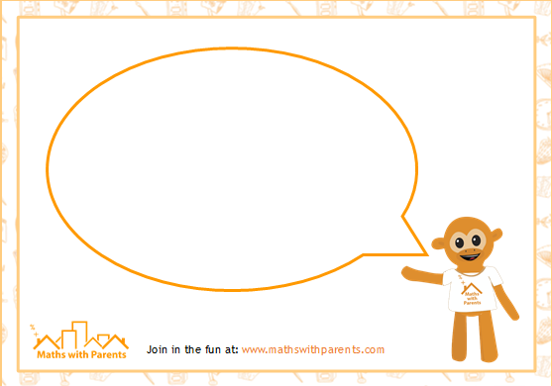
What Next?
Maths with Parents activities will be set every two weeks
Have fun completing them together at home and send through lots of feedback and photos for us!
Keep an eye on dojo for celebrating the reviews and photos sent in.
Always look at the windows of your child’s class to keep updated: You will see updates in a bubble like this:
Notes:
Edit for your school – how often are you setting work, are there any other expectations you want to set or extras ideas you have incorporated in school such as Maths with Parents notice board, certificates in assemblies etc.

Slide 24
Setting up your Account

Slide 25
Registration
Visit www.mathswithparents.com
Click ‘Log In’, then ‘New Parent’
Enter your child’s class code:
Class Teacher | Class Name | Class Code
Mrs Ryder | Nursery | 564357
Miss Smith & Mrs Cowley | R1 | 126002
Miss Carr | R2 | 307935
Mrs Larkin | 1L | 355744
Miss Scott (Mrs Rigby) | 1S | 197459
Mrs Allerston | 2A | 107637
Miss Greene | 2G | 793349
If you have more than one child, just add one at this stage. You will have the option to add a second child once you have logged in.
Please complete the short survey – then you are ready to get started!
Notes:
Teachers need to input class codes for your classes here
Getting logged in is really quick and easy. Will do this right away. The site is designed to work well on mobile phones and the majority of parents access it in this way. If anyone does not have a phone with them or would prefer to use a school laptop etc. please say.
Visit www.mathswithparents.com
Click ‘Log In’, then ‘New Parent’
Enter your child’s class code:

Slide 26
@parentmaths
info@mathswithparents.com
/MathswithParents

Slide 27
Adding Another Child or Parent
Adding Another Child
Log in to your account
At the bottom of your page there is a ‘Add another child’ icon:
Click on this button
Enter your other child’s class code
Enter their name, and then click ‘Confirm’
Adding Another Parent
You can add as many parents, grandparents, carers etc. as required.
They will need to register the same way from the start – just make sure everyone spells the child’s name exactly the same.
You will then all have access to the same account
Notes:
Adding another child – if there are twins, it can sometimes work better to have them both as the same – so just one account with first name e.g. Charlie and Betty surname e.g. Smith. This means parents will only need to login and complete comments once (it also means they will have the same Mathscot)
Adding another parent – this is really simple and often so important in ensuring all pupils have an opportunity to play the games – particularly where there is shared responsibility for the child.

